Slide 1
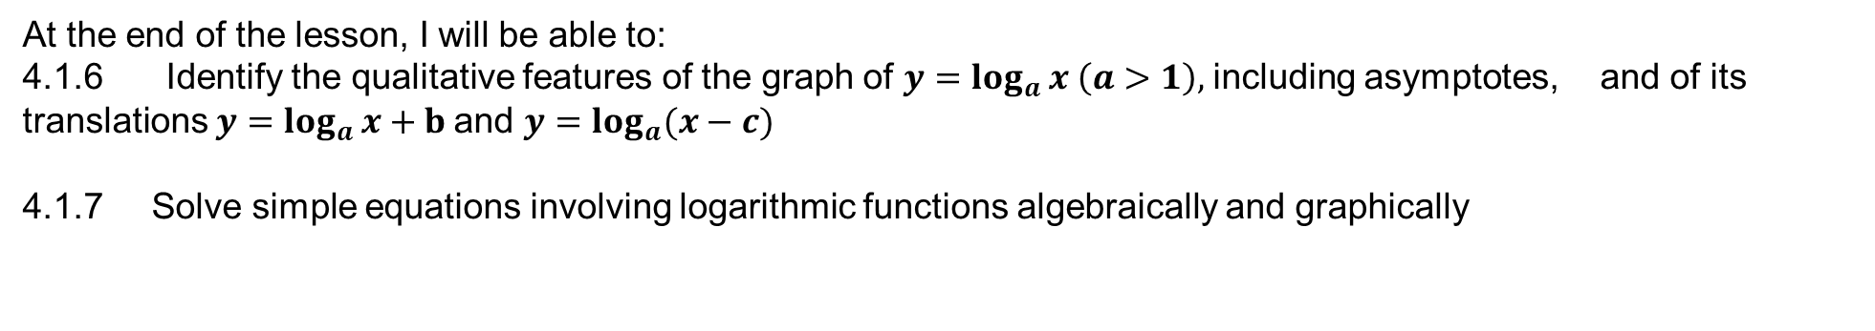
Learning Objective
I will be able to determine the rules of logarithms functions.
Success Criteria
At the end of the lesson, I will be able to:
4.1.6 Identify the qualitative features of the graph of $y=\log_{a}{x}$ $\left(a>1\right),$including asymptotes, and of its translations $y=\log_{a}{x}+b$and $y=\log_{a}{(x−c)}$
4.1.7 Solve simple equations involving logarithmic functions algebraically and graphically

Slide 2
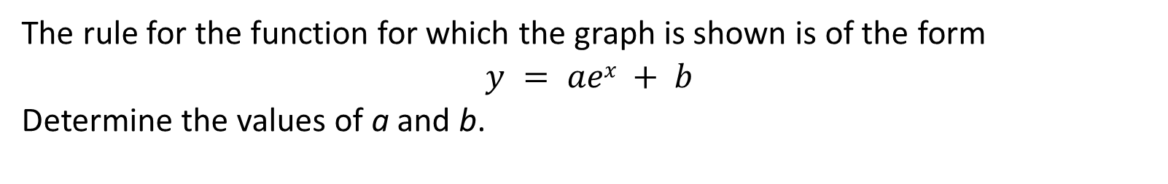

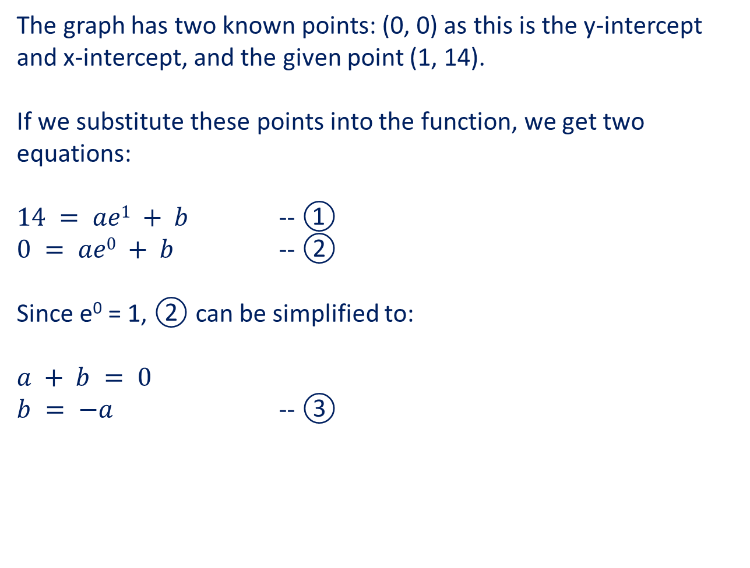
Guided Practice
The rule for the function for which the graph is shown is of the form
$$y = aex + b$$
Determine the values of a and b.
The graph has two known points: (0, 0) as this is the y-intercept and x-intercept, and the given point (1, 14).
If we substitute these points into the function, we get two equations:
$14 = ae1 + b$ -- ①
$0 = ae0 + b$ -- ②
Since e⁰ = 1, ② can be simplified to:
$a + b = 0$
$b = −a$ -- ③
If $b = −a$, substituting ③ into ①
$14 = ae1 – a$
$14 = a(e – 1)$
$a = \frac{14}{e−1}$
Hence b = $−\left(\frac{14}{e−1}\right)= \frac{−14}{1−e}$

Slide 3
Guided Practice
Determine the rule for the graph on the right in the form y = A log_{e}(x – h)
Where x = -1 and y = 0,
0 = A log_{e}(-1 – h)
0 = log_{e}(-1 – h)
e⁰ = -1 – h
1 = -1 – h
h = -2
Since y = A log_{e}(x + 2), when x = 2 and y = 3 ln(4)
3 ln(4) = A ln(2 + 2) Hence, y = 3 log_{e}(x + 2)
3 ln(4) = A ln(4)
A = 3

Slide 4
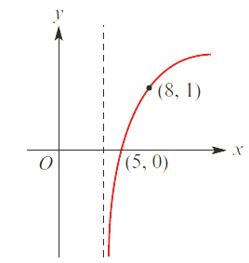




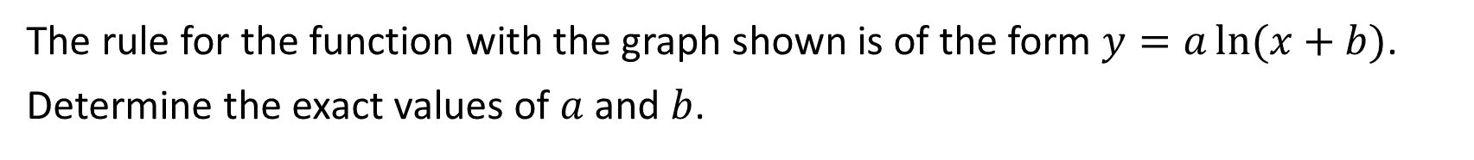



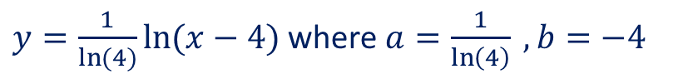


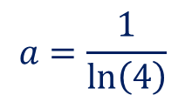
Guided Practice
The rule for the function with the graph shown is of the form $y=a\ln{(x+b)}$.
Determine the exact values of $a$ and $b$.
$$0=a\ln\left(5+b\right) −−−(1)$$
$$1=a\ln\left(8+b\right) −−−(2)$$
$$\left(1\right), \ln{(5+b)}=0$$
$$5+b=e^{0}$$
$$b=e^{0}−5$$
$$b=1−5$$
$$b=−4$$
Sub $b=−4$ into $(2)$
$$1=a\ln\left(8−4\right)$$
$$a=\frac{1}{\ln\left(4\right)}$$
$y=\frac{1}{\ln{(4)}}\ln{(x−4)}$ where $a=\frac{1}{\ln\left(4\right)} , b=−4$

Slide 5
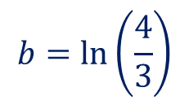
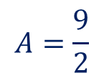

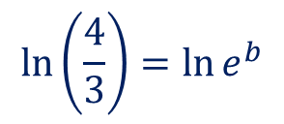
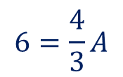
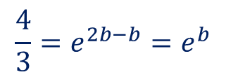

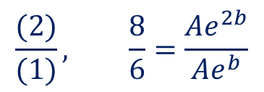



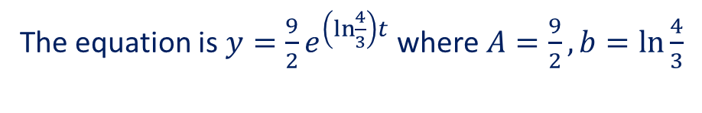
Guided Practice
Given that $y=Ae^{bt}$ with $y=6$ when $t=1$ and $y=8$ when $t=2$.
Determine the exact values of $A$ and $b$.
$$6=Ae^{b} −−−(1)$$
Sub $b$ into $\left(1\right),$
$$8=Ae^{2b}−−−(2)$$
$$6=Ae^{\ln\left(\frac{4}{3}\right)}$$
$$\frac{(2)}{(1)}, \frac{8}{6}=\frac{Ae^{2b}}{Ae^{b}}$$
$$6=Ae^{\ln\left(\frac{4}{3}\right)}$$
$$\frac{4}{3}=e^{2b−b}=e^{b}$$
$$6=\frac{4}{3}A$$
$$\ln\left(\frac{4}{3}\right)=\ln{e^{b}}$$
$$A=\frac{9}{2}$$
$$b=\ln\left(\frac{4}{3}\right)$$
The equation is $y=\frac{9}{2}e^{\left(\ln{\frac{4}{3}}\right)t}$ where $A=\frac{9}{2}, b=\ln{\frac{4}{3}}$

Slide 6
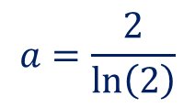


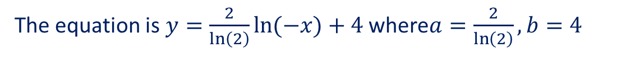






Guided Practice
The graph of the function with the rule $f\left(x\right)=a\ln{(−x)}+b$ passes through the points $(−2,6)$ and $(−4,8)$. Determine the values of $a$ and $b$.
$$6=a\ln{(2)}+b −−−(1)$$
$$8=a\ln{(4)}+b−−−(2)$$
$$\left(2\right)−\left(1\right), 2=a\ln\left(4\right)−a\ln{(2)}$$
$$2=a\left(\ln\left(4\right)−\ln\left(2\right)\right)$$
$$2=a\ln{(2)}$$
$$a=\frac{2}{\ln\left(2\right)}$$
Sub $a$ into (1)
$$6=2+b$$
$$b=4$$
The equation is $y=\frac{2}{\ln\left(2\right)}\ln{(−x)}+4$ where$a=\frac{2}{\ln\left(2\right)}, b=4$

Slide 7
Independent Practice
Complete Ex 2F + JKlup worksheet

